Slide 1


A Complete Society Management System
Notes:
NESTIN simplify the complexities of RWA operations and helps build a better communication system between the residents and RWA

Slide 2
ABOUT NESTIN
Nestin helps manage Housing Society by connecting and involving residents. Administrator can perform management task using web interface while user can perform task like authorizing guests, raising tickets, share opinion or discuss on a subject through web interface or Android interface while on the go.
Notes:
Nestin .. A society management system

Slide 3
OUR VISION
1
3
Our vision is to provide ease of living, better security, and better communications to the societies.
Our Vision is to carter the emerging need for a better management solution of these gated communities.
2
4
The gated communities are small cities within walls consisting of a large number of people residing in more than hundred of apartments
We pave the way for these communities to work in a well-integrated environment and help improve RWA operations
Notes:
Our vision

Slide 4
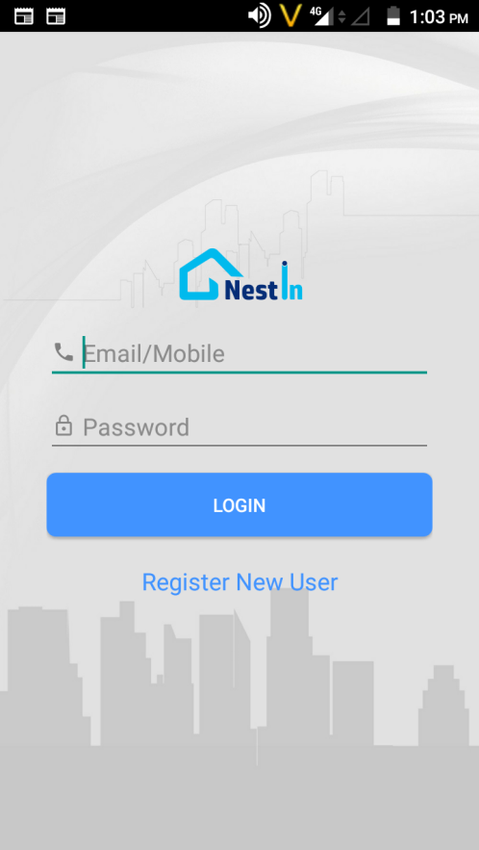
NESTIN the right solution..
Solid Backend Infrastructure
Our application is built with the latest technologies, with all data security measures
Easy To Understand Interface
No complex or fancy features, simple and easy for everyone to use .No complex solution. We
Data updates in runtime
All the information, instructions, notification and data/reports are available and get updated in real time.
Continuous Evolving
Instead of overwhelmed with unnecessary features, we continuously aim to improve and evolve as per user feedback and usage.
Excellent Customer Support
Dedicated customer support from user activation to application complain. Our team is always available.
Access from any device our app has both web and mobile version, accessible from anywhere, anytime
Customization
Your society has a unique requirement and we understand that.We provide customized add on's as per your request
Notes:
Why Choose Us?

Slide 5





for all your society
management requirements
• Complaint Management
• Vendor Directory
• Visitor Management
• SMS Notification
• Rent in & Rent Out • Sale & Purchase
• Notice Board
• Forum & Discussions
Notes:
Nestin a complete solution to all your problems…. Making everyday life easy and efficient in gated communities

Slide 6
Owner/ Tenant records
The system maintains the data history of all user type which can access the application. This include Flats, it’s owners, Tenants and Employees. Even for Tenants movement in and out of society and their authorization by owner is kept recorded for future references.
Notes:
Now manage large complex tenant's data easily, disseminate important notice to all the residents in one go! Forget worrying about maintaining a register for bill payments and dues. NESTIN!! empowering your society digitally.

Slide 7
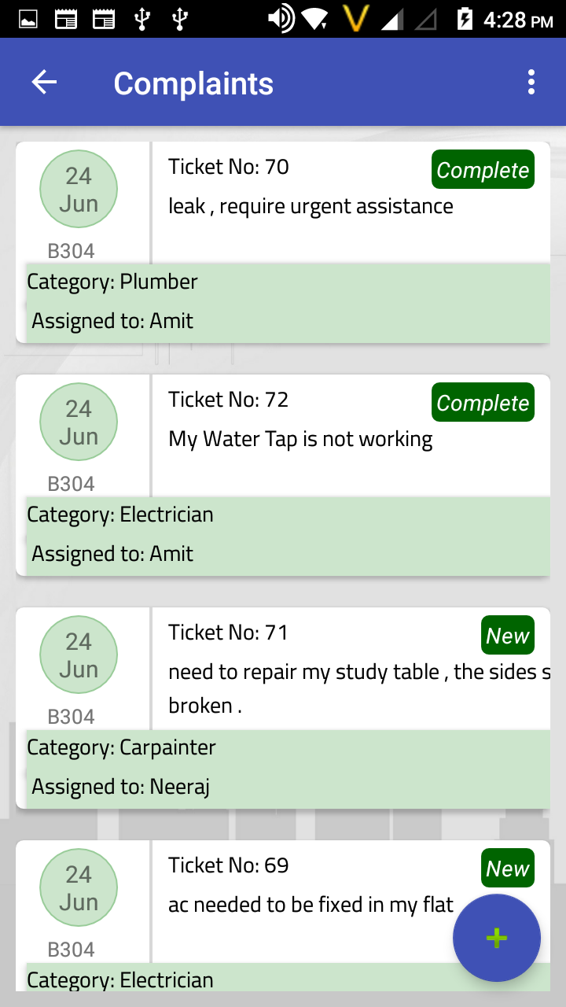
Complaint
Residents can raise complaint using Web and mobile interface anytime anywhere, which will be automatically be assigned to concerned person with out waiting for someone to assign it.
This assignment will not only look for concerned person, but will also look at his engagement. The complete movement of complaint resolution process is stored and used for analysis like Average Age,
Complaints frequency in each category and capacity utilization.
Notes:
Now know what's happening in your society with a click, get update on vendors and rate services, auto assign complaints to the concerned personnel, pay and maintain bills easily.

Slide 8
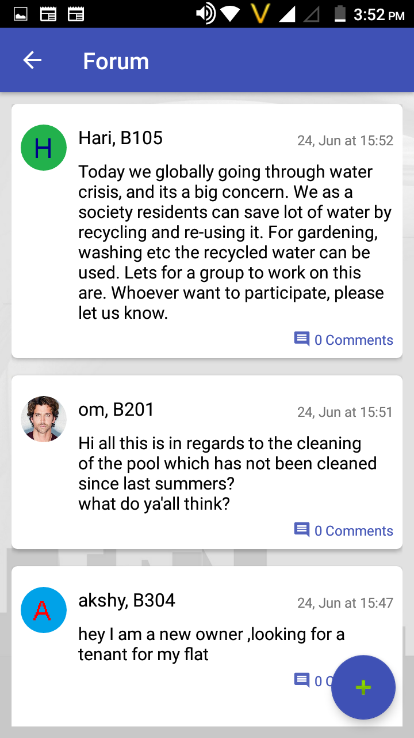
Forum & Discussion
Residents can use this internal discussion platforms for sharing views and information to their fellow residents. There are plenty of topics in society where residents need discussion and brain storming for future decision making or may be taking initiative like garbage handling, plantation, future events or any other social topic.
Notes:
All the latest news, topic of discussion and share your opinion with everyone in the society..

Slide 9
Ride Share
Ride with people you trust
YES
YES
YES
.
Riding Noida today. Anyone Interested to pool with me?

Slide 10
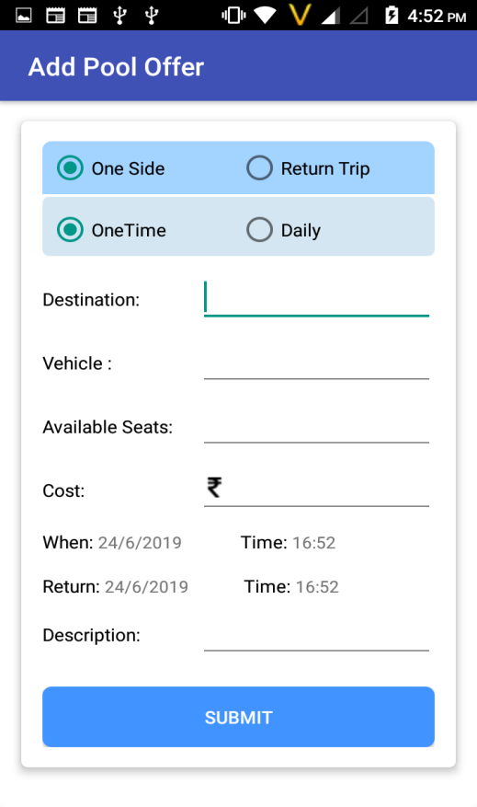
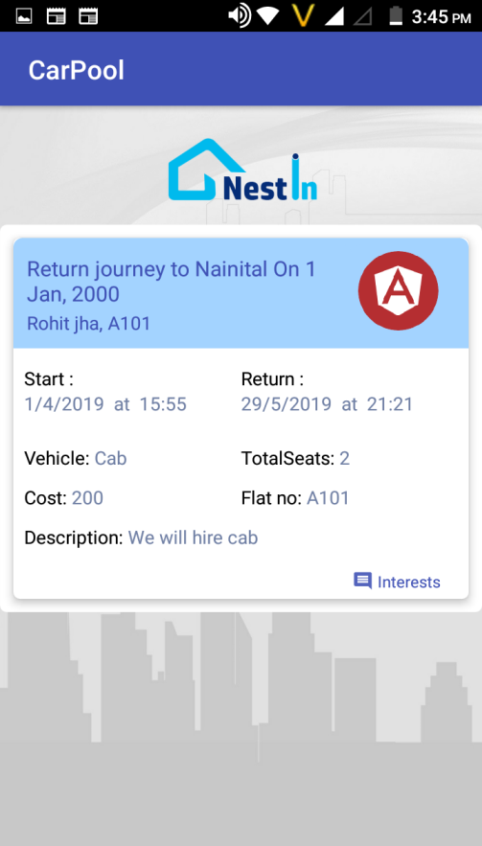
Ride Share it’s a simple process
Now ride with people you trust from within your society
Call the person who show interest and book your pool. Happy Ride share
Its simple Add your pool offer
Select destination & negotiate on the price and submit

Slide 11
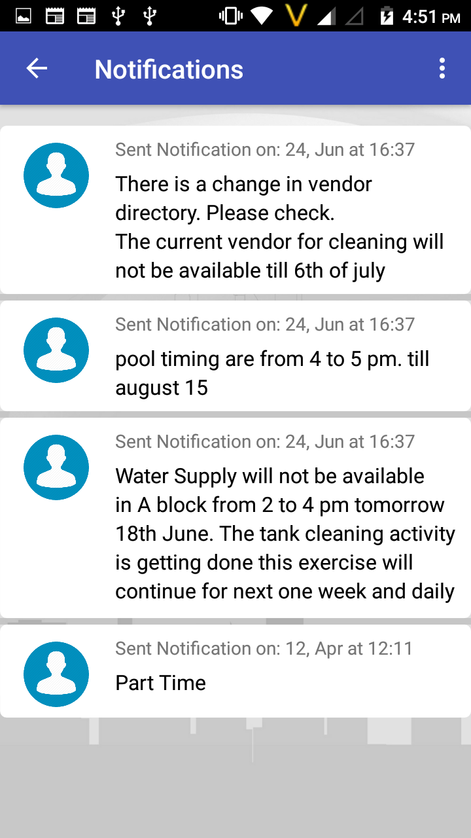
SMS Notification There are
There are many official message RWA wants to communicate to residents like any upcoming event, change in policy, obstruction in some service etc. Residents with their busy life find it difficult to follow the RWA Communication. This function help residents to see the communications anytime from anywhere. Any official communication from RWA office bearer will reach timely to all residents
Notes:
Get all the notification about important events and notice via call and sms on your smartphones

Slide 12
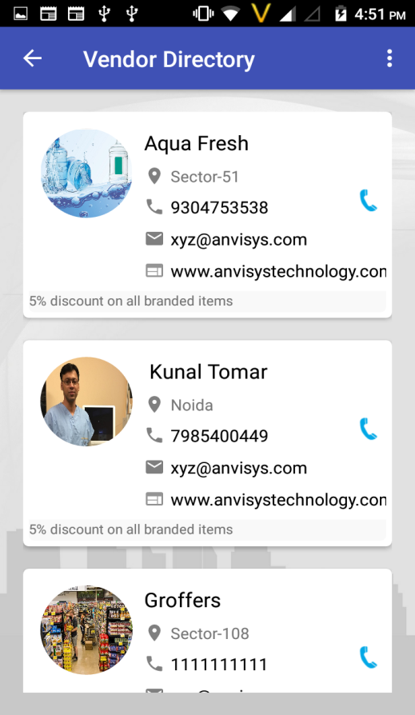
Vendors
There are many vendors providing services to your society be it Water suppliers, Newspaper Vendor, Milk Vendor etc. With this function residents need not to run around asking contact information from guard, neighbours or searching visiting cards. Open application, go to vendor list and you have it even the recently added vendor.
.
Notes:
Now upgrade your society with NESTIN. An app for all your day to day problems, from vendor management, advanced security system to share your ride feature and much more all in just one app.

Slide 13
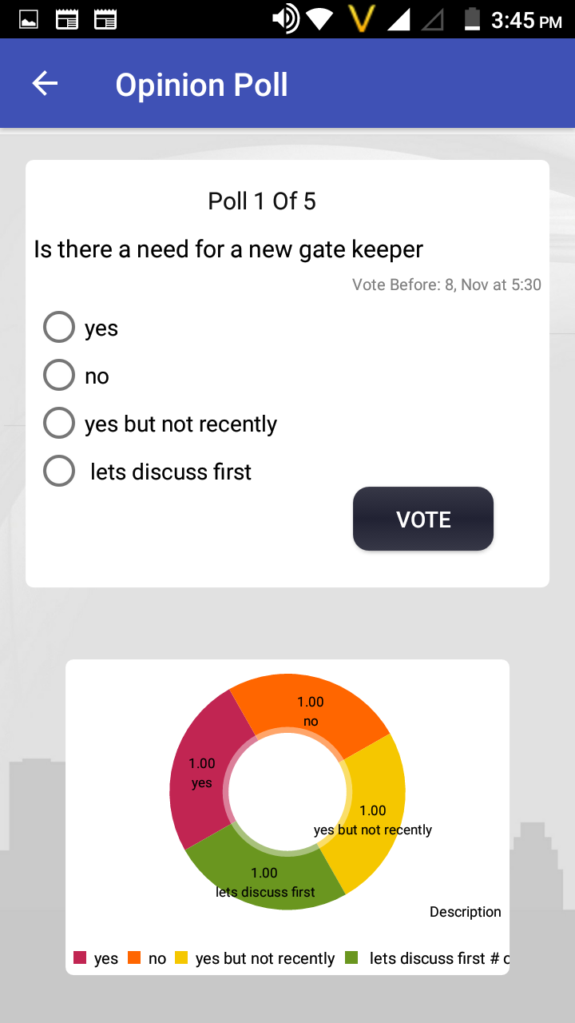
Opinion
Staying together and not having difference of opinion is not possible. Different people have different opinion in a society, and to take a collaborative decision RWA need to collect everyone’s view. RWA can conduct a poll in your society before taking decision on any topic you want.
.
I VOTE FOR IT
NO
YES
YES
Notes:
Vote and share your opinions via Opinion poll feature in Nestin app. Because your opinion matter’s

Slide 14
Security
****
New Process
Old Process
• Enter Visitor data with Time in Application- Mobile or Web
• Visitor / Guard calls from gate.
VS
• Visitor gets on OTP on sms.
• You takes call on Intercom • If misses, Guest provide
• At Guard tells OTP to Guard • Guard verify OTP and allow
mobile no. to call
check in.
• Make entry in Register
With the growing number of large societies in new residential area,
the security is becoming a major challenge. There is very high footfall on gate, mostly resulting in queue . In case of any unfortunate incidents it is very difficult retrieve the information from manual
register.
Security is never perfect but needs continuous improvement to
overcome the new threats..
Notes:
Nestin replaces the old vary security process of your gated communities into a better efficient and safer system.

Slide 15



Benefits for the stakeholders
RWA’s
Residents
Vendors
• Originated in India
• Initially was used in Europe
• Originated in Germany
• Believes in permanent healing
• Provides instant relief
• Believes in permanent healing
• Focus on root cause of the ailment • Environment friendly medicines
• Symptoms and not the cause
• Focus on root cause of the ailment • Medicines prepared through
• Medicines made from chemicals • Expensive line of treatments
• Cost Effective procedure
dilution of alcohol/distelled water • Safe for children/no side effects
• Side effects with overdose
Notes:
The content needs to be changed kindly look into the slide as it’s content is from shobit.

Slide 16
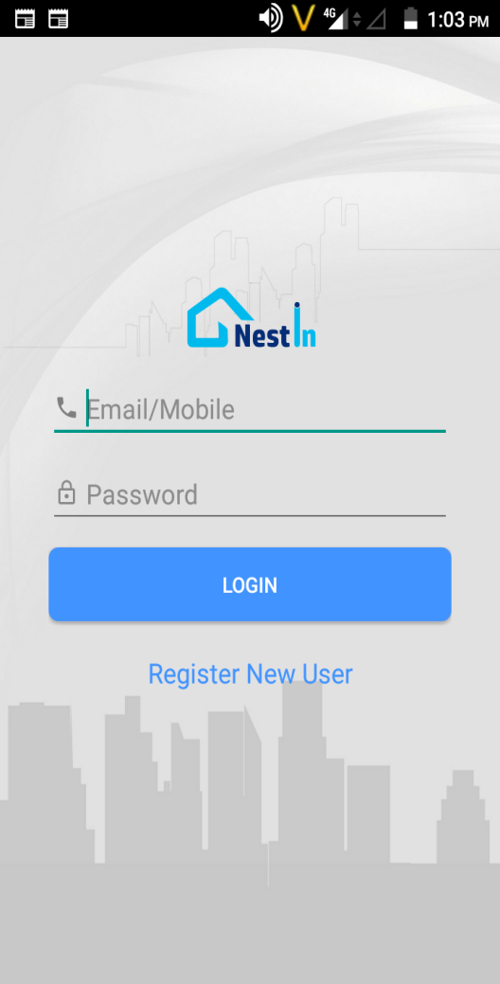
Product features
Society Management Other Features
• Services/Complaints
• Rent in & Rent Out, • Sale & Purchase
• Security/Guest Entry
• Notices and Information
• Advertisements
• Bills and Payments
• Vendor Registration
• Discussion / Forum
• Vendor Directory
• Opinion Polls
DATE AND TIME

Slide 17
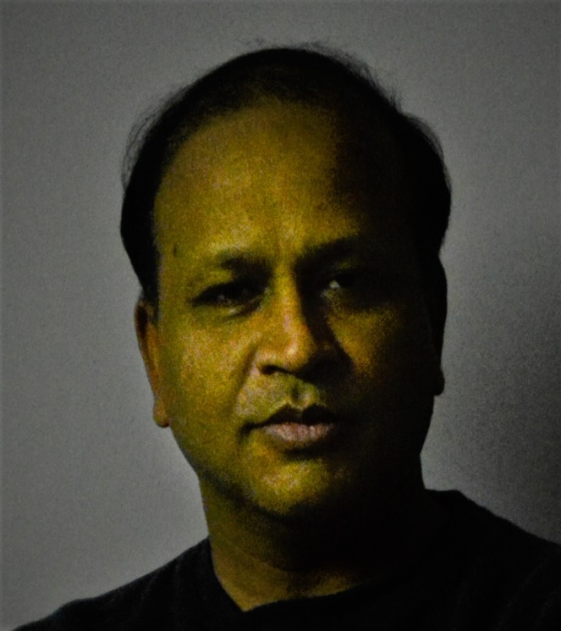
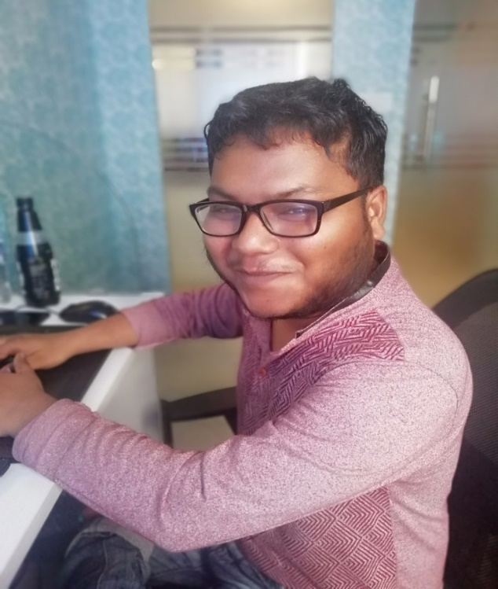
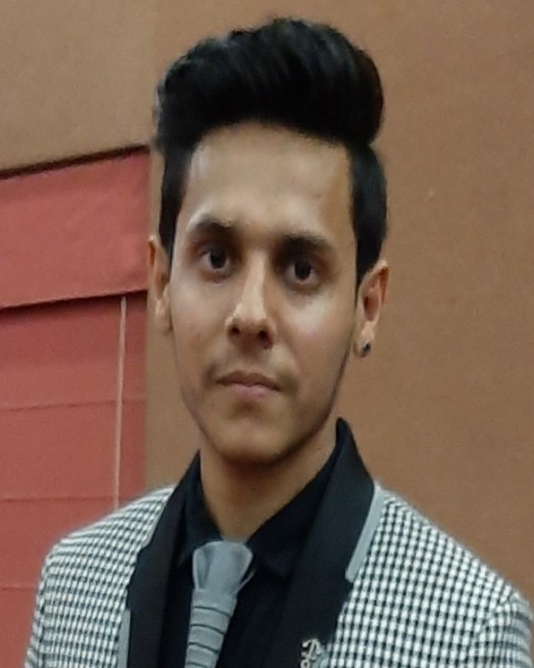
Amit Bansal
Sagar Srivastava
Shivang Bhatnagar
DI R EC T O R M.Tech.- IIT Roorkee
A N D O I D DEVE L O P E R
W E B DE V E LO P E R
B.E. Computer Science
B.E. Computer Science
18 Years Experience
3 Year Experience
2 Year Experience

Slide 18

Peaceful Homes

